Slide 1
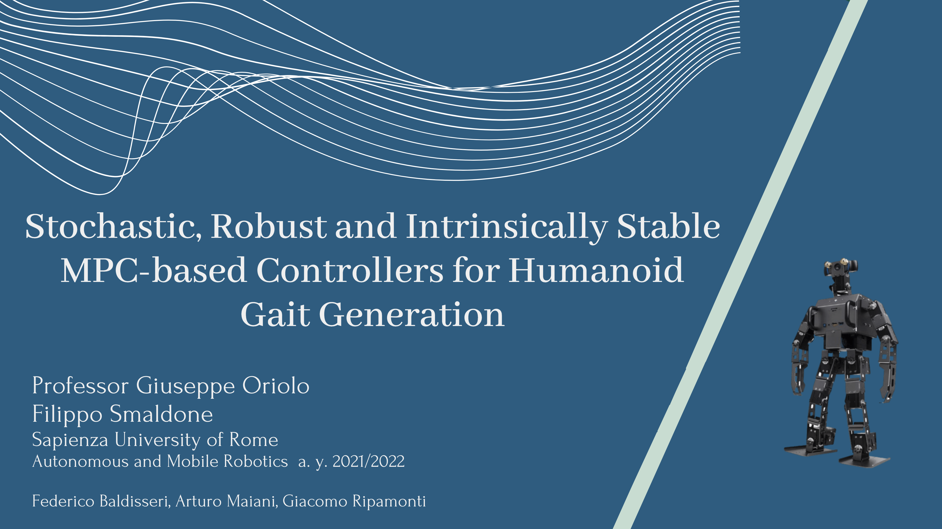

Slide 2

Introduction
Physical model
Model Predictive Control
Simulations
Conclusions
Nominal MPC
Tube-based Robust MPC
Stochastic MPC
Intrinsically stable MPC
Parameters
Implementation details
Constant disturbance simulations
Stochastic disturbance simulations
Disturbance rejection simulations

Slide 3

INTRODUCTION
Motivations
In presence of disturbances, the performance of MPC-based controllers typically deteriorates, possibly leading to constraint violation.
In the case of humanoid gait generation, this can cause the loss of dynamic balance and internal instability with the subsequent fall of the robot.
Objectives
The objective of this project is to implement a Stochastic-MPC-based gait generation algorithm for humanoids which is able to guarantee robustness in presence of disturbances.
Such algorithm is compared with a Nominal MPC, a Tube-based Robust MPC [1] and a robust Internally Stable MPC [2].
The designed method is validated through simulations in Matlab.

Slide 4

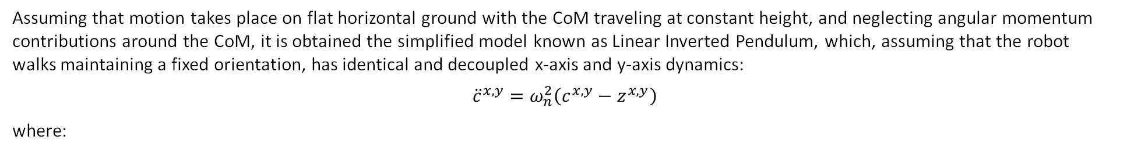
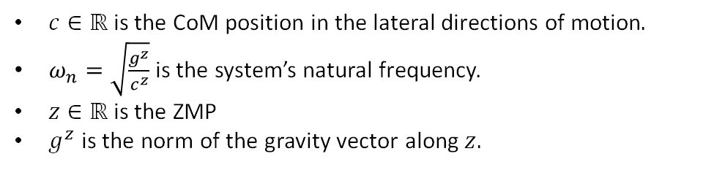
PHYSICAL MODEL
Zero Moment Point
The gait generation is based on the Zero Moment Point $→$ Point on the ground for which the horizontal component of the moment of the ground reaction forces becomes zero.
It ensures dynamic balance if kept inside the support polygon of the robot.
It can be indirectly controlled by generating an appropriate Center of Mass trajectory, which is then kinematically tracked.
Dynamic model
Assuming that motion takes place on flat horizontal ground with the CoM traveling at constant height, and neglecting angular momentum contributions around the CoM, it is obtained the simplified model known as Linear Inverted Pendulum, which, assuming that the robot walks maintaining a fixed orientation, has identical and decoupled x-axis and y-axis dynamics:
$${\ddot{c}}^{x,y}=ω_{n}^{2}\left(c^{x,y}−z^{x,y}\right)$$
where:
$c∈ℝ$ is the CoM position in the lateral directions of motion$.$
$ω_{n}=\sqrt{\frac{g^{z}}{c^{z}}}$ is the system’s natural frequency.
$z∈ℝ$ is the ZMP
$g^{z}$ is the norm of the gravity vector along $z.$

Slide 5
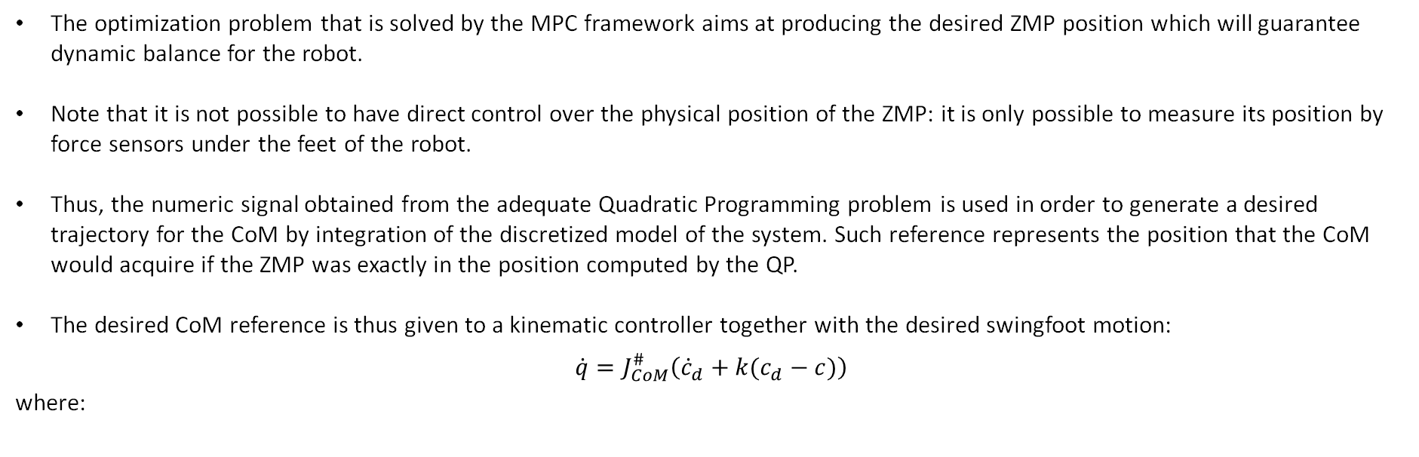
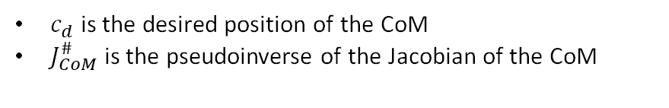
PHYSICAL MODEL
ZMP as a virtual control signal
The optimization problem that is solved by the MPC framework aims at producing the desired ZMP position which will guarantee dynamic balance for the robot.
Note that it is not possible to have direct control over the physical position of the ZMP: it is only possible to measure its position by force sensors under the feet of the robot.
Thus, the numeric signal obtained from the adequate Quadratic Programming problem is used in order to generate a desired trajectory for the CoM by integration of the discretized model of the system. Such reference represents the position that the CoM would acquire if the ZMP was exactly in the position computed by the QP.
The desired CoM reference is thus given to a kinematic controller together with the desired swingfoot motion:
$$\dot{q}=J_{CoM}^{\#}\left({\dot{c}}_{d}+k(c_{d}−c)\right)$$
where:
$c_{d}$ is the desired position of the CoM
$J_{CoM}^{\#}$ is the pseudoinverse of the Jacobian of the CoM

Slide 6
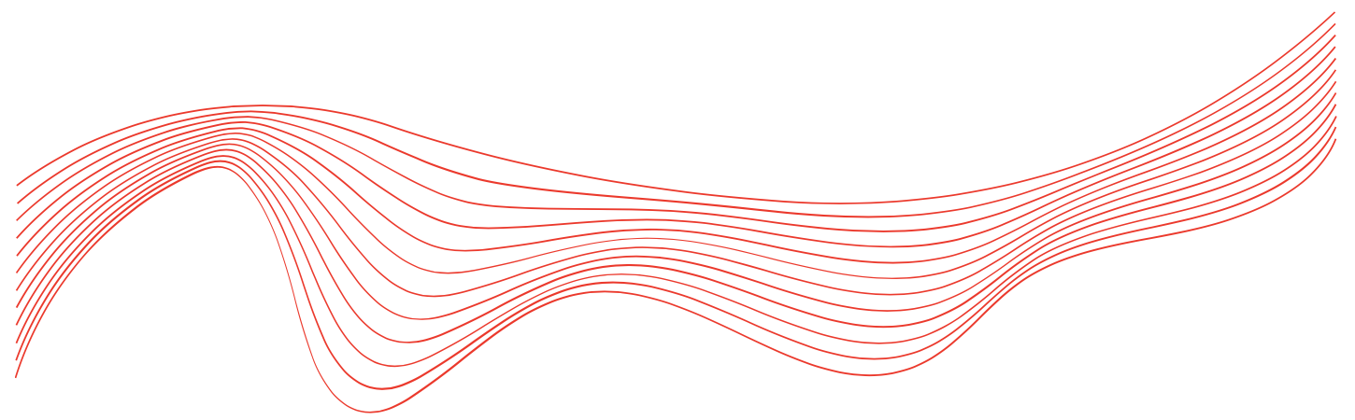
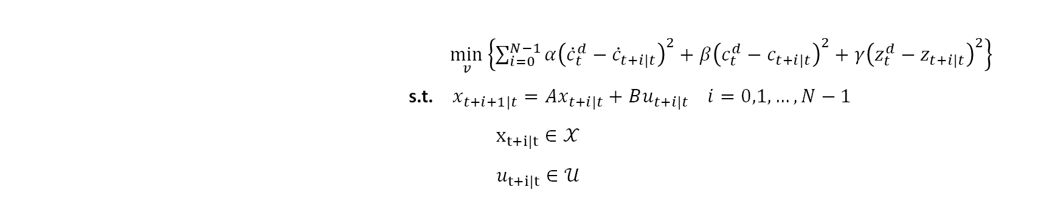
MODEL PREDICTIVE CONTROL
1 Nominal Model Predictive Control
The Nominal MPC is implemented as a benchmark.
In the following it is briefly recalled its formulation:
$\min_{v}\left\{\sum_{i=0}^{N−1}{α{\left({\dot{c}}_{t}^{d}−{\dot{c}}_{t+i|t}\right)}^{2}+{β\left(c_{t}^{d}−c_{t+i|t}\right)}^{2}+γ{\left(z_{t}^{d}−z_{t+i|t}\right)}^{2}}\right\}$
s.t. $x_{t+i+1|t}={Ax}_{t+i|t}+Bu_{t+i|t} i=0,1,…,N−1$
$x_{t+i|t}∈𝒳$
$u_{t+i|t}∈𝒰$
where:
The cost index represents the trajectory tracking error, which is minimized
$𝒳$ is the admissibility region for the state, limiting the coronal CoM oscillation
$𝒰$ is the admissibility region for the control, i.e., the convex hull

Slide 7
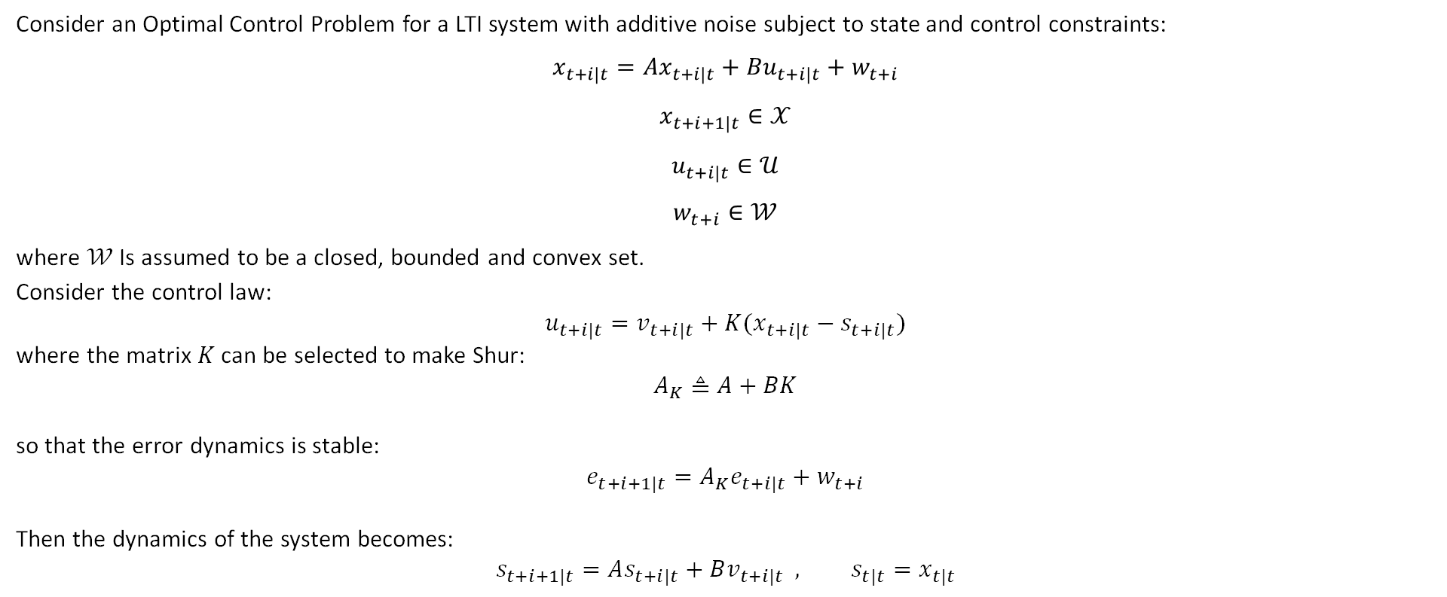
MODEL PREDICTIVE CONTROL
2 Tube-based Robust Model Predictive Control
Consider an Optimal Control Problem for a LTI system with additive noise subject to state and control constraints:
$$x_{t+i|t}={Ax}_{t+i|t}+{Bu}_{t+i|t}+w_{t+i}$$
$$x_{t+i+1|t}∈𝒳$$
$$u_{t+i|t}∈𝒰$$
$$w_{t+i}∈𝒲$$
where $𝒲$ Is assumed to be a closed, bounded and convex set.
Consider the control law:
$$u_{t+i|t}=v_{t+i|t}+K(x_{t+i|t}−s_{t+i|t})$$
where the matrix $K$ can be selected to make Shur:
$$A_{K}≜A+BK$$
so that the error dynamics is stable:
$$e_{t+i+1|t}=A_{K}e_{t+i|t}+w_{t+i}$$
Then the dynamics of the system becomes:
$$s_{t+i+1|t}=As_{t+i|t}+Bv_{t+i|t} , s_{t|t}=x_{t|t}$$

Slide 8
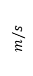
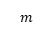
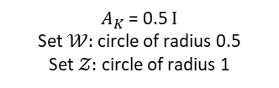
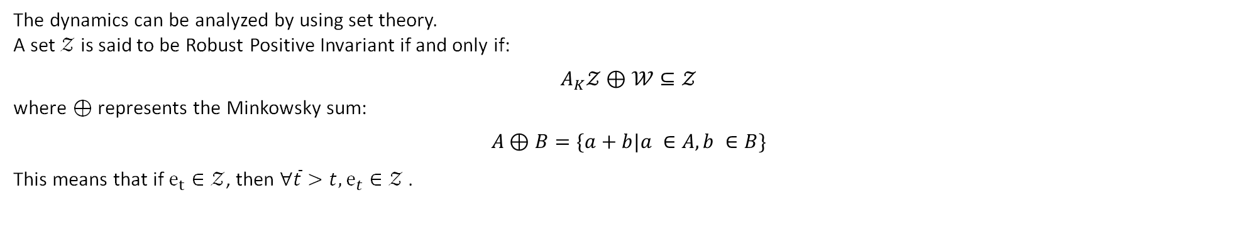
MODEL PREDICTIVE CONTROL
The dynamics can be analyzed by using set theory.
A set $𝒵$ is said to be Robust Positive Invariant if and only if:
$$A_{K}𝒵⊕𝒲⊆𝒵$$
where $⊕$ represents the Minkowsky sum:
$$A⊕B=\{a+b|a ∈A, b ∈B\}$$
This means that if $e_{t}∈𝒵$, then $∀\overline{t}>t, e_{t}∈𝒵$.
$$m/s$$
$A_{K}$ = 0.5 $Ι$
Set $𝒲:$circle of radius 0.5
Set $𝒵:$ circle of radius 1
$$m$$

Slide 9
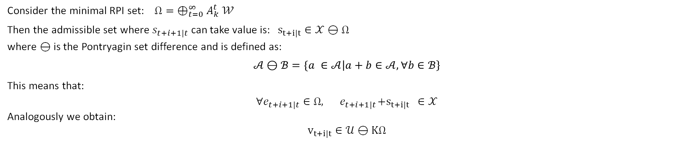

MODEL PREDICTIVE CONTROL
Consider the minimal RPI set: $Ω= ⊕_{t=0}^{∞}A_{k}^{t}$ $𝒲$
Then the admissible set where $s_{t+i+1|t}$ can take value is: $s_{t+i|t}∈𝒳⊖$ $Ω$
where ⊖ is the Pontryagin set difference and is defined as:
$$𝒜⊖ℬ=\{a ∈𝒜\left|a+b∈𝒜,∀b∈ℬ\right\}$$
This means that:
$$∀e_{t+i+1|t}∈Ω,{ e}_{t+i+1|t}+s_{t+i|t} ∈𝒳$$
Analogously we obtain:
$$v_{t+i|t}∈𝒰⊖KΩ$$
$\min_{v}{\{ J(s_{t}, v)\}}$
s.t. $s_{t+i+1|t}={As}_{t+i|t}+Bv_{t+i|t} i=0,1,…,N−1$
$s_{t+i|t}∈𝒳⊖ Ω$
$v_{t+i|t}∈𝒰⊖KΩ$
$s_{t|t}=x_{t}$
Thus, the final formulation is:

Slide 10
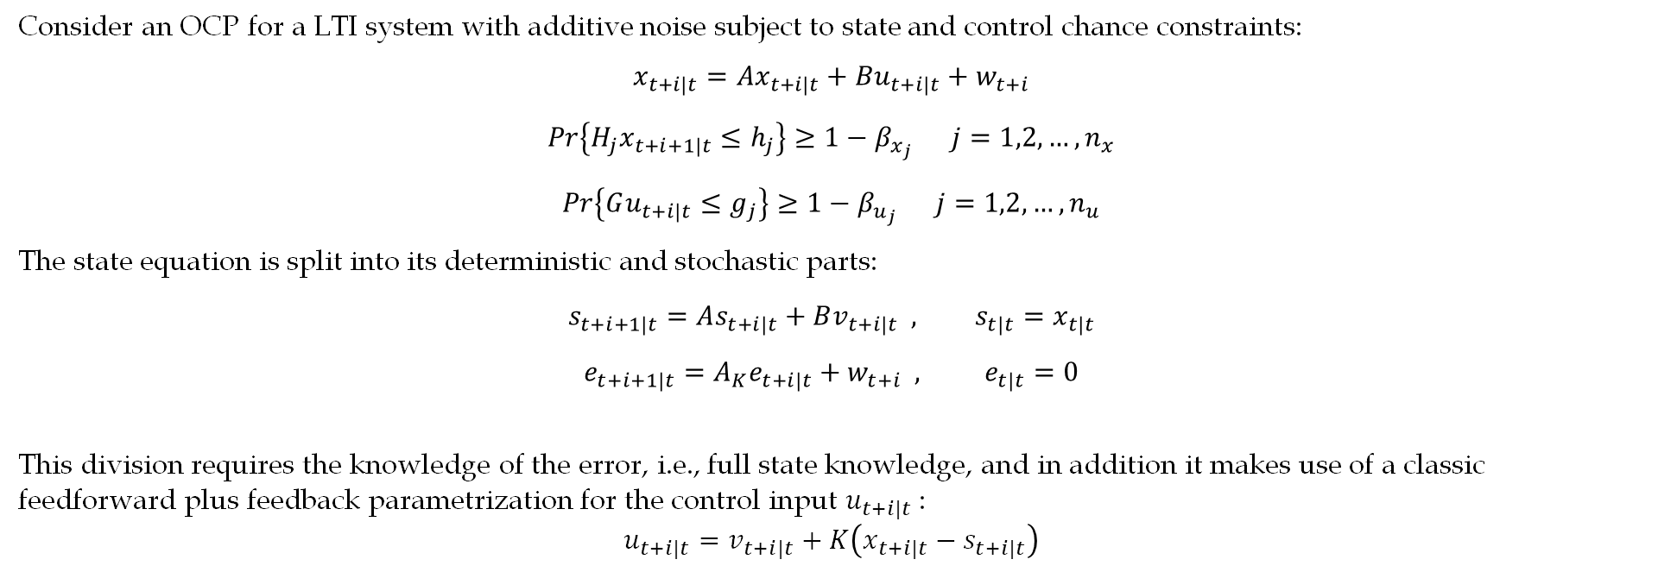
MODEL PREDICTIVE CONTROL
3 Stochastic Model Predictive Control
Consider an OCP for a LTI system with additive noise subject to state and control chance constraints:
$$x_{t+i|t}={Ax}_{t+i|t}+{Bu}_{t+i|t}+w_{t+i}$$
$$Pr\left\{H_{j}x_{t+i+1|t}≤h_{j}\right\}≥1−β_{x_{j}} j=1,2,…,n_{x}$$
$$Pr\left\{Gu_{t+i|t}≤g_{j}\right\}≥1−β_{u_{j}} j=1,2,…,n_{u}$$
The state equation is split into its deterministic and stochastic parts:
$$s_{t+i+1|t}=As_{t+i|t}+Bv_{t+i|t} , s_{t|t}=x_{t|t}$$
$$e_{t+i+1|t}=A_{K}e_{t+i|t}+w_{t+i} , e_{t|t}=0$$
This division requires the knowledge of the error, i.e., full state knowledge, and in addition it makes use of a classic feedforward plus feedback parametrization for the control input $u_{t+i|t}$:
$$u_{t+i|t}=v_{t+i|t}+K\left(x_{t+i|t}−s_{t+i|t}\right)$$

Slide 11
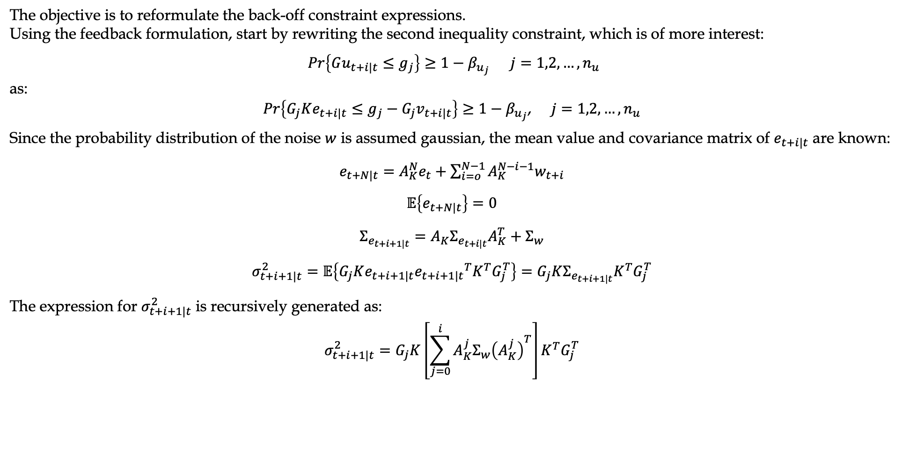
MODEL PREDICTIVE CONTROL
The objective is to reformulate the back-off constraint expressions.
Using the feedback formulation, start by rewriting the second inequality constraint, which is of more interest:
$Pr\left\{Gu_{t+i|t}≤g_{j}\right\}≥1−β_{u_{j}} j=1,2,…,n_{u}$
as:
$Pr\left\{G_{j}Ke_{t+i|t}≤g_{j}−G_{j}v_{t+i|t}\right\}≥1−β_{u_{j}}$, $j=1,2,…,n_{u}$
Since the probability distribution of the noise $w$ is assumed gaussian, the mean value and covariance matrix of $e_{t+i|t}$ are known:
$e_{t+N|t}=A_{K}^{N}e_{t}+\sum_{i=o}^{N−1}{A_{K}^{N−i−1}w_{t+i}}$
$$𝔼\left\{e_{t+N|t}\right\}=0$$
$$Σ_{e_{t+i+1|t}}=A_{K}Σ_{e_{t+i|t}}A_{K}^{T}+Σ_{w}$$
$$σ_{t+i+1|t}^{2}=𝔼\left\{G_{j}Ke_{t+i+1|t}{e_{t+i+1|t}}^{T}K^{T}G_{j}^{T}\right\}=G_{j}KΣ_{e_{t+i+1|t}}K^{T}G_{j}^{T}$$
The expression for $σ_{t+i+1|t}^{2}$ is recursively generated as:
$$σ_{t+i+1|t}^{2}=G_{j}K\left[\sum_{j=0}^{i}{A_{K}^{j}Σ_{w}{\left(A_{K}^{j}\right)}^{T}}\right]{K^{T}G}_{j}^{T}$$

Slide 12
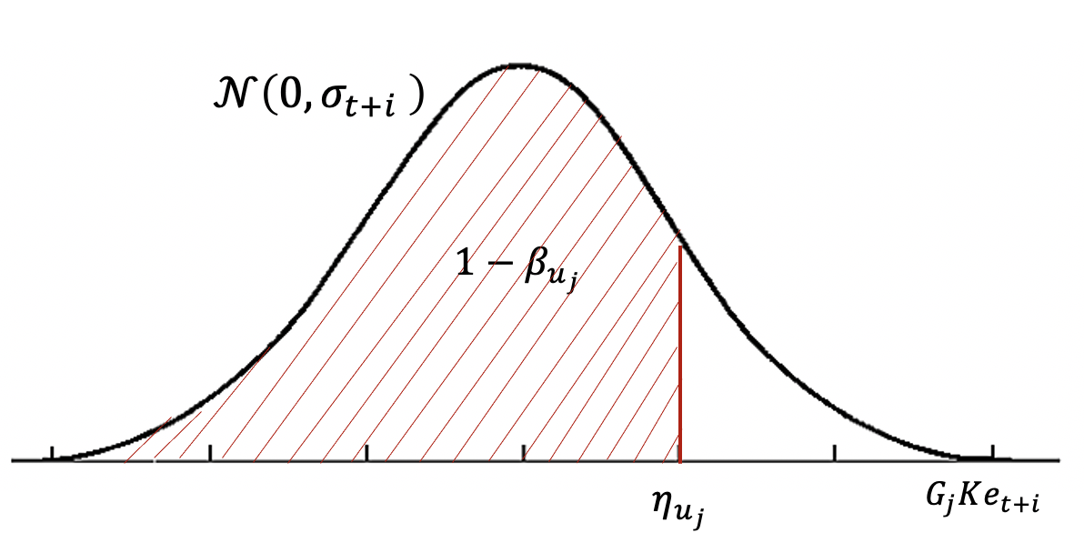

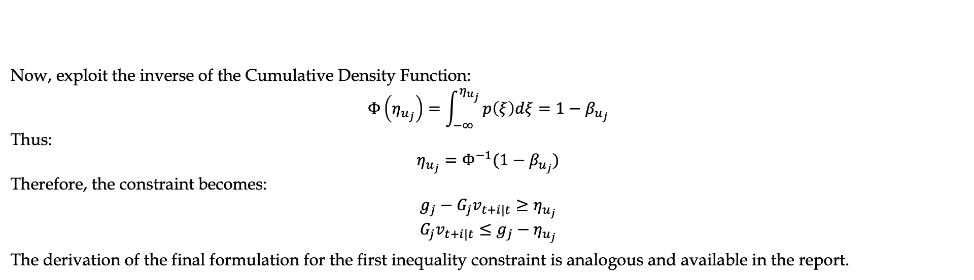
MODEL PREDICTIVE CONTROL
Now, exploit the inverse of the Cumulative Density Function:
$$Φ\left(η_{u_{j}}\right)=\int_{−∞}^{η_{u_{j}}}{p\left(ξ\right)dξ=1−β_{u_{j}}}$$
Thus:
$$η_{u_{j}}=Φ^{−1}(1−β_{u_{j}})$$
Therefore, the constraint becomes:
$$g_{j}−G_{j}v_{t+i|t}≥η_{u_{j}}$$
$$G_{j}v_{t+i|t}≤g_{j}−η_{u_{j}}$$
The derivation of the final formulation for the first inequality constraint is analogous and available in the report.
cacca
Final formulation:
$\min_{v}{𝔼\left\{J(s_{t}, v)\}\right\}}$
s.t. $s_{t+i+1|t}={As}_{t+i|t}+Bv_{t+i|t} i=0,1,…,N−1$
$$H_{j}s_{t+i+1|t}≤h_{j}−η_{x} j=1,2,…,n_{x}$$
$$G_{j}v_{t+i|t}≤g_{j}−η_{u_{j}} j=1,2,…,n_{u}$$
$s_{t|t}=x_{t}$

Slide 13
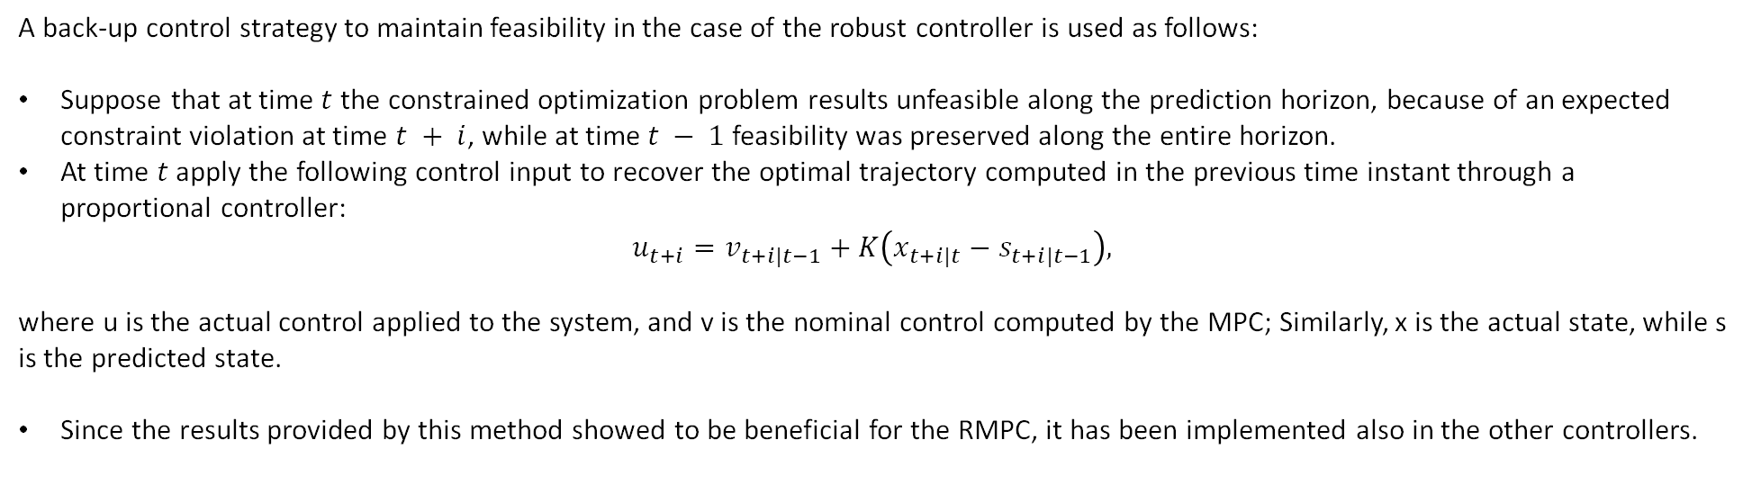
MODEL PREDICTIVE CONTROL
Recursive feasibility
A back-up control strategy to maintain feasibility in the case of the robust controller is used as follows:
Suppose that at time $t$ the constrained optimization problem results unfeasible along the prediction horizon, because of an expected constraint violation at time $t + i$, while at time $t − 1$feasibility was preserved along the entire horizon.
At time $t$ apply the following control input to recover the optimal trajectory computed in the previous time instant through a proportional controller:
$$u_{t+i}=v_{t+i|t−1}+K\left(x_{t+i|t}−s_{t+i|t−1}\right),$$
where u is the actual control applied to the system, and v is the nominal control computed by the MPC; Similarly, x is the actual state, while s is the predicted state.
Since the results provided by this method showed to be beneficial for the RMPC, it has been implemented also in the other controllers.

Slide 14
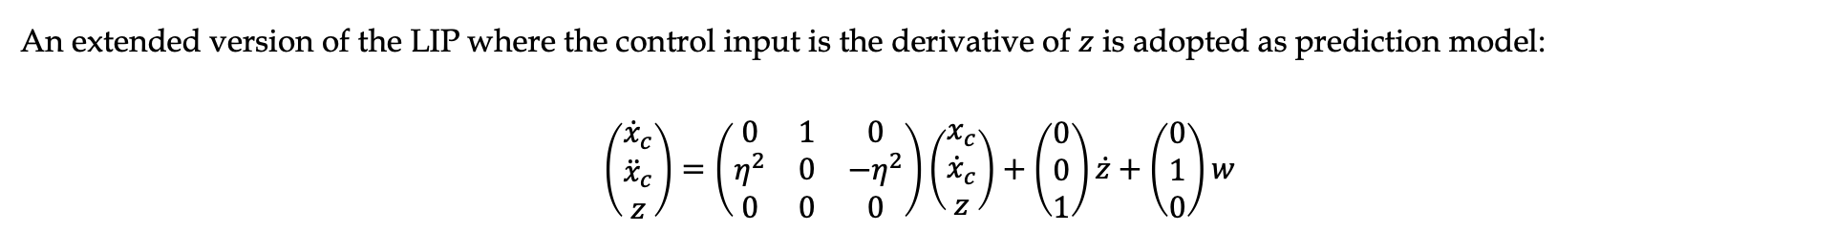
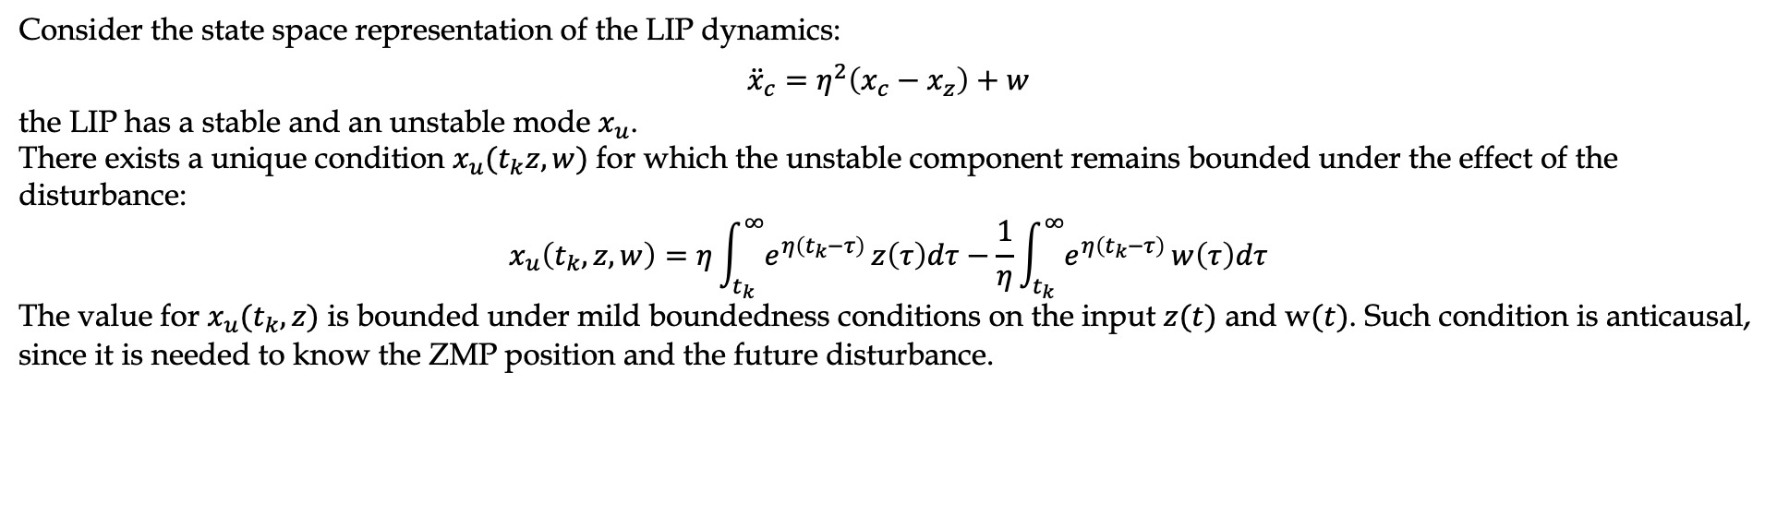
MODEL PREDICTIVE CONTROL
4 Intrinsically Stable Model Predictive Control
Consider the state space representation of the LIP dynamics:
$${\ddot{x}}_{c}=η^{2}\left(x_{c}−x_{z}\right)+w$$
the LIP has a stable and an unstable mode $x_{u}$.
There exists a unique condition $x_{u}(t_{k}z,w)$ for which the unstable component remains bounded under the effect of the disturbance:
$$x_{u}\left(t_{k},z,w\right)=η\int_{t_{k}}^{∞}{e^{η\left(t_{k}−τ\right)}}z\left(τ\right)dτ−\frac{1}{η}\int_{t_{k}}^{∞}{e^{η\left(t_{k}−τ\right)}}w\left(τ\right)dτ$$
The value for $x_{u}(t_{k},z)$ is bounded under mild boundedness conditions on the input $z(t)$ and w$(t)$. Such condition is anticausal, since it is needed to know the ZMP position and the future disturbance.
An extended version of the LIP where the control input is the derivative of $z$ is adopted as prediction model:
$$\left(\begin{matrix}{\dot{x}}_{c} \\ {\ddot{x}}_{c} \\ z\end{matrix}\right)=\left(\begin{matrix}0 & 1 & 0 \\ η^{2} & 0 & −η^{2} \\ 0 & 0 & 0\end{matrix}\right)\left(\begin{matrix}x_{c} \\ {\dot{x}}_{c} \\ z\end{matrix}\right)+\left(\begin{matrix}0 \\ 0 \\ 1\end{matrix}\right)\dot{z}+\left(\begin{matrix}0 \\ 1 \\ 0\end{matrix}\right)w$$

Slide 15
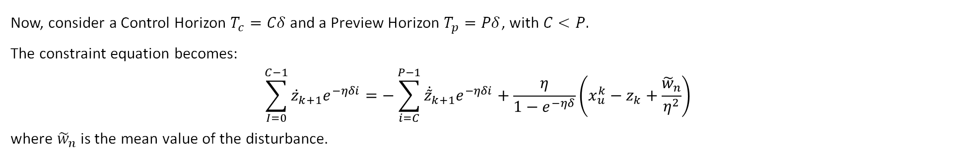
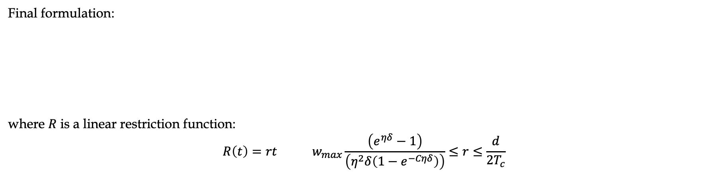

MODEL PREDICTIVE CONTROL
Now, consider a Control Horizon $T_{c}=Cδ$ and a Preview Horizon $T_{p}=Pδ$, with $C<P.$
The constraint equation becomes:
$$\sum_{I=0}^{C−1}{{\dot{z}}_{k+1}e^{−ηδi}=−\sum_{i=C}^{P−1}{{\dot{\tilde{z}}}_{k+1}e^{−ηδi}+\frac{η}{1−e^{−ηδ}}\left(x_{u}^{k}−z_{k}+\frac{{\tilde{w}}_{n}}{η^{2}}\right)}}$$
where ${\tilde{w}}_{n}$ is the mean value of the disturbance.
$$\min_{{\dot{Z}}_{k}}\left\{{\left\|{\dot{Z}}_{k}\right\|}^{2}\right\}$$
s.t. $\sum_{I=0}^{C−1}{{\dot{z}}_{k+1}e^{−ηδi}=−\sum_{i=C}^{P−1}{{\dot{\tilde{z}}}_{k+1}e^{−ηδi}+\frac{η}{1−e^{−ηδ}}\left(x_{u}^{k}−z_{k}+\frac{{\tilde{w}}_{n}}{η^{2}}\right)}}$
$z_{min}\left(t\right)+R\left(t−t_{k}\right)≤z\left(t\right)≤z_{max}\left(t\right)−R(t−t_{k})$
Final formulation:
where $R$ is a linear restriction function:
$$R\left(t\right)=rt w_{max}\frac{\left(e^{ηδ}−1\right)}{\left(η^{2}δ\left(1−e^{−Cηδ}\right)\right)}≤r≤\frac{d}{2T_{c}}$$

Slide 16

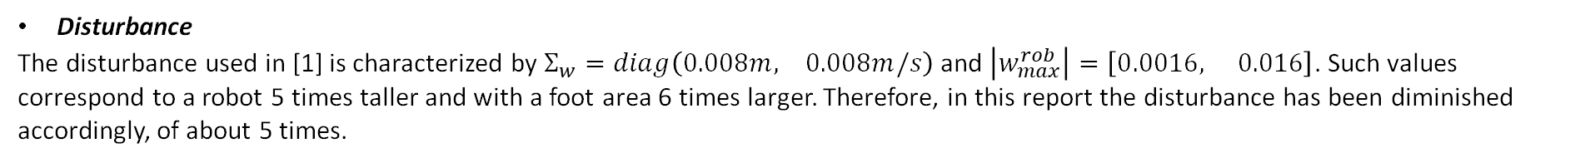
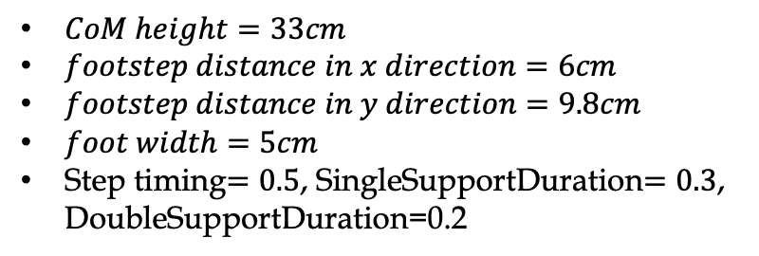
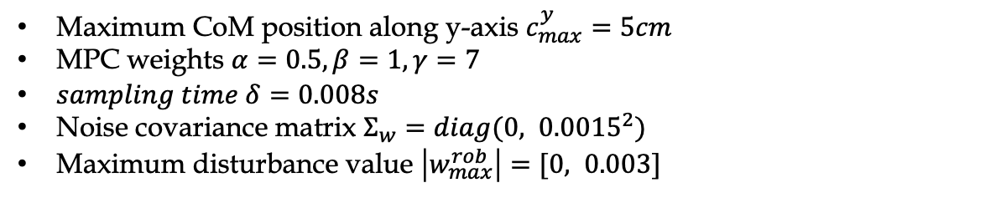
SIMULATIONS
Parameters
The following numerical parameters have been used for the simulations:
$CoM height=33cm$
$footstep distance in x direction=6cm$
$footstep distance in y direction=9.8cm$
$foot width=5cm$
Step timing$=0.5$, SingleSupportDuration$=0.3$, DoubleSupportDuration=0.2
Maximum CoM position along y-axis $c_{max}^{y}=5cm$
MPC weights $α=0.5, β=1, γ=7$
$sampling time δ=0.008s$
Noise covariance matrix $Σ_{w}=diag(0, {0.0015}^{2})$
Maximum disturbance value $\left|w_{max}^{rob}\right|=[0, 0.003]$
Implementation details
Disturbance
The disturbance used in [1] is characterized by $Σ_{w}=diag\left(0.008m, 0.008m/s\right)$ and $\left|w_{max}^{rob}\right|=\left[0.0016, 0.016\right]$. Such values correspond to a robot 5 times taller and with a foot area 6 times larger. Therefore, in this report the disturbance has been diminished accordingly, of about 5 times.

Slide 17
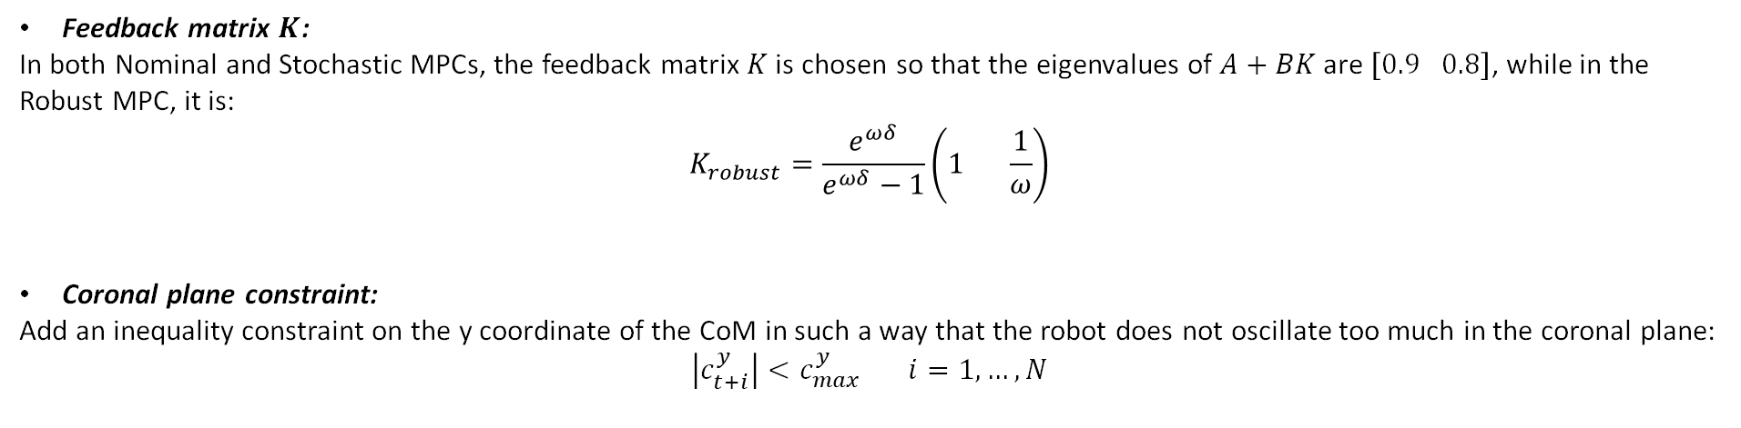
SIMULATIONS
Feedback matrix $K$:
In both Nominal and Stochastic MPCs, the feedback matrix $K$ is chosen so that the eigenvalues of $A+BK$ are $\left[0.9 0.8\right]$, while in the Robust MPC, it is:
$$K_{robust}=\frac{e^{ωδ}}{e^{ωδ}−1}\left(1 \frac{1}{ω}\right)$$
Coronal plane constraint:
Add an inequality constraint on the y coordinate of the CoM in such a way that the robot does not oscillate too much in the coronal plane:
$$\left|c_{t+i}^{y}\right|<c_{max}^{y} i=1,…,N$$
Solver:
The problem is solved in MATLAB using the function quadprog.

Slide 18
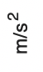

SIMULATIONS
Footprint reduction $η$:
The x-axis represents the receding horizon of the controller, while the y-axis represents the reduction of the ZMP foot constraint for each side of the foot.

Slide 19
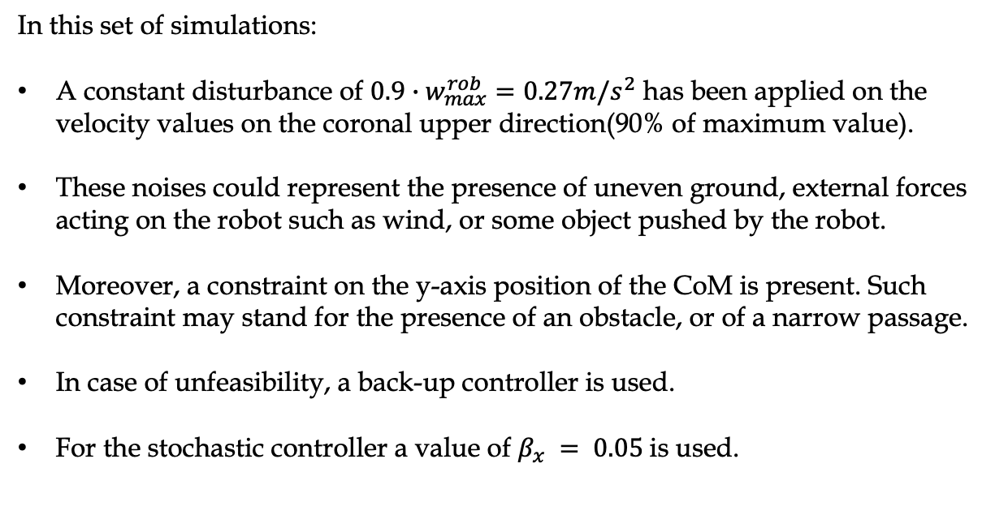
SIMULATIONS
Constant disturbance simulations
In this set of simulations:
A constant disturbance of $0.9∙w_{max}^{rob}=0.27m/s^{2}$ has been applied on the velocity values on the coronal upper direction(90% of maximum value).
These noises could represent the presence of uneven ground, external forces acting on the robot such as wind, or some object pushed by the robot.
Moreover, a constraint on the y-axis position of the CoM is present. Such constraint may stand for the presence of an obstacle, or of a narrow passage.
In case of unfeasibility, a back-up controller is used.
For the stochastic controller a value of $β_{x} = 0.05$is used.

Slide 20
SIMULATIONS
Constant disturbance simulations
Nominal controller
Robust controller
Stochastic controller
The robot falls
As expected, the robust method performs better than the probabilistic one, because of the disturbance being constant: the CoM is kept more centered.
Moreover, with the probabilistic controller some occasional violation of the constraint on the CoM position occurred.

Slide 21
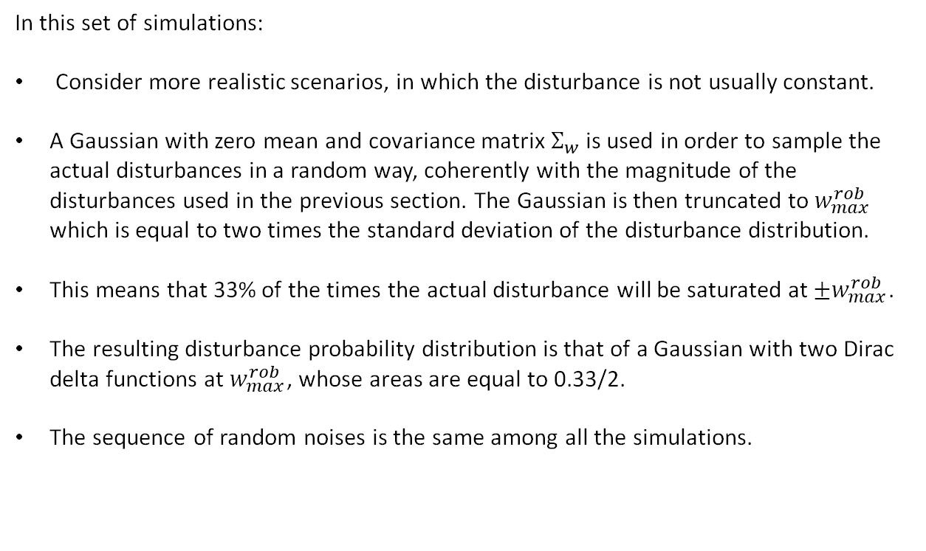
SIMULATIONS
Stochastic disturbance simulations
In this set of simulations:
Consider more realistic scenarios, in which the disturbance is not usually constant.
A Gaussian with zero mean and covariance matrix $Σ_{w}$ is used in order to sample the actual disturbances in a random way, coherently with the magnitude of the disturbances used in the previous section. The Gaussian is then truncated to $w_{max}^{rob}$ which is equal to two times the standard deviation of the disturbance distribution.
This means that 33% of the times the actual disturbance will be saturated at $±w_{max}^{rob}$.
The resulting disturbance probability distribution is that of a Gaussian with two Dirac delta functions at $w_{max}^{rob}$, whose areas are equal to 0.33/2.
The sequence of random noises is the same among all the simulations.

Slide 22
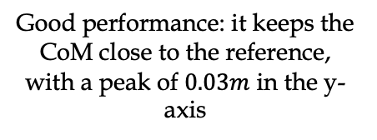
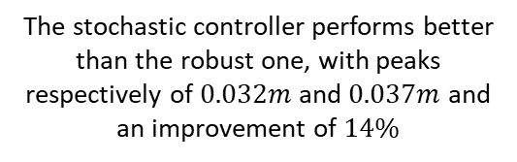
SIMULATIONS
Stochastic disturbance simulations
Nominal controller
Robust controller
Stochastic controller
Robust IS controller
Good performance: it keeps the CoM close to the reference, with a peak of $0.03m$ in the y-axis
The stochastic controller performs better than the robust one, with peaks respectively of $0.032m$ and $0.037m$ and an improvement of $14\%$
In order to evaluate the quality of the proposed algorithm, it is performed a comparison with the IS-MPC controller from [2].
As expected, the evolution of the ZMP is smoother in the IS-MPC case with respect to the previous ones, since it is a dynamically extended model.
In addition, taking into account the oscillations from the x-axis of the CoM, these two figures show similar behaviours.
None of the controllers violates any constraint.

Slide 23
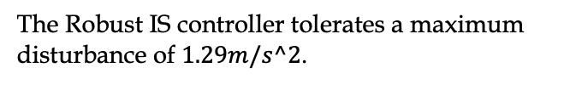
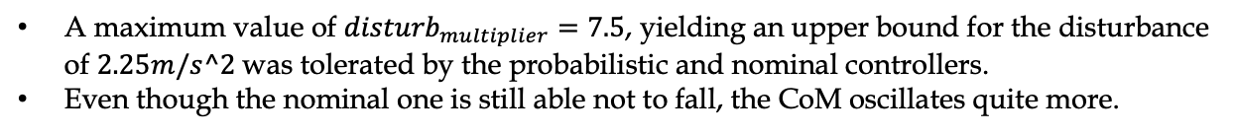
SIMULATIONS
Disturbance rejection simulations
This set of simulations aims at identifying the controller which tolerates the strongest disturbance, still using the casual disturbance. A parameter called ${disturb}_{multiplier}$ was used in order to incrementally augment the injected disturbance.
Nominal controller
Stochastic controller
Robust IS controller
A maximum value of ${disturb}_{multiplier}=7.5$, yielding an upper bound for the disturbance of $2.25m/s^2$was tolerated by the probabilistic and nominal controllers.
Even though the nominal one is still able not to fall, the CoM oscillates quite more.
The Robust IS controller tolerates a maximum disturbance of $1.29m/s^2$.
The robust controller was not able to find a solution, due to unfeasibility of the QP: it does not work with expected disturbances which are too strong, since the available foot area is restricted too much.
As opposed to the robust controller, the probabilistic one can still be used when the expected disturbance is significantly strong.

Slide 24
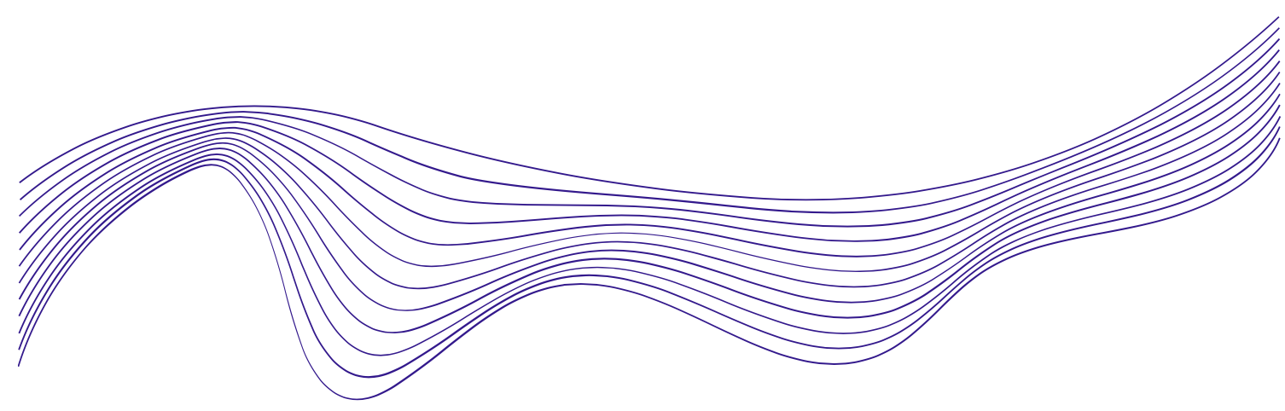
CONCLUSIONS
Discussion
This project has developed a Stochastic-MPC-based gait generation algorithm for humanoids which is able to guarantee robustness in presence of disturbances.
Such algorithm has been compared with a Nominal MPC, a Robust MPC and a robust IS-MPC. Note that in particular the IS-MPC controller is able to consider disturbance signals which vary around a mid-range value that can change at each sampling time, yielding a bias in the disturbance range.
Finally, the designed method has been validated through Matlab simulations.
In particular, the probabilistic controller has shown to be the most convenient choice among the first three:
On the other hand, the Robust IS controller yields the smallest available footprint reduction and the smoothest ZMP evolution.
It yields more guarantees with respect to the nominal controller: in the case of a constant disturbance - or sequences of disturbances acting in the same directions - it is able to let the robot maintain balance, whereas the nominal controller fails.
It shows better performances with respect to the robust controller in the cases of random disturbances: the extremely conservative behaviour of the latter prevents it from reaching good performances in terms of CoM oscillations.
As shown in the disturbance rejection simulations, the RMPC is also unusable in the case of large expected disturbances, as the available support polygon becomes too small. On the other hand, the Stochastic-MPC is able to cope with them.
Future work
Carry on Gazbo implementation and simulations.
Perform simulations on a real OP-3 robot.

Slide 25
REFERENCES
[1] Ahmad Gazar et al. “Stochastic and Robust MPC for Bipedal Locomotion: A Comparative Study on Robustness and Performance”. In: 2020 IEEE-RAS 20th International Conference on Humanoid Robots (Humanoids). 2021, pp. 61–68.
[2] Filippo M. Smaldone et al. “ZMP Constraint Restriction for Robust Gait Generation in Humanoids”. In: 2020 IEEE International Conference on Robotics and Automation (ICRA). 2020, pp. 8739–8745.
[3] Leonardo Lanari, Seth Hutchinson, and Luca Marchionni. “Boundedness issues in planning of locomotion trajectories for biped robots”. English (US). In: 2014 IEEE-RAS International Conference on Humanoid Robots, Humanoids 2014. IEEE Computer Society, Feb. 2015, pp. 951–958.

Slide 26


